Slide 1

Attention is not Explanation
Sarthak Jain, Byron C. Wallace - Northeastern University
21 Feb 2020
Presenter: Sanchit Sinha
https://qdata.github.io/deep2Read/

Slide 2
Motivation
Attention mechanisms are being used to demonstrate transparency in standard NLP downstream tasks - text classification, question answering and natural language inference
Is attention actually explaining the outputs of models trained for such tasks?
If yes, perform extensive experiments to assess the degree to which attention weights provide “meaningful explanations" for predictions
Similar in essence to the sanity check paper - experiment idea and design is similar
Notes:
The motivation of this project

Slide 3
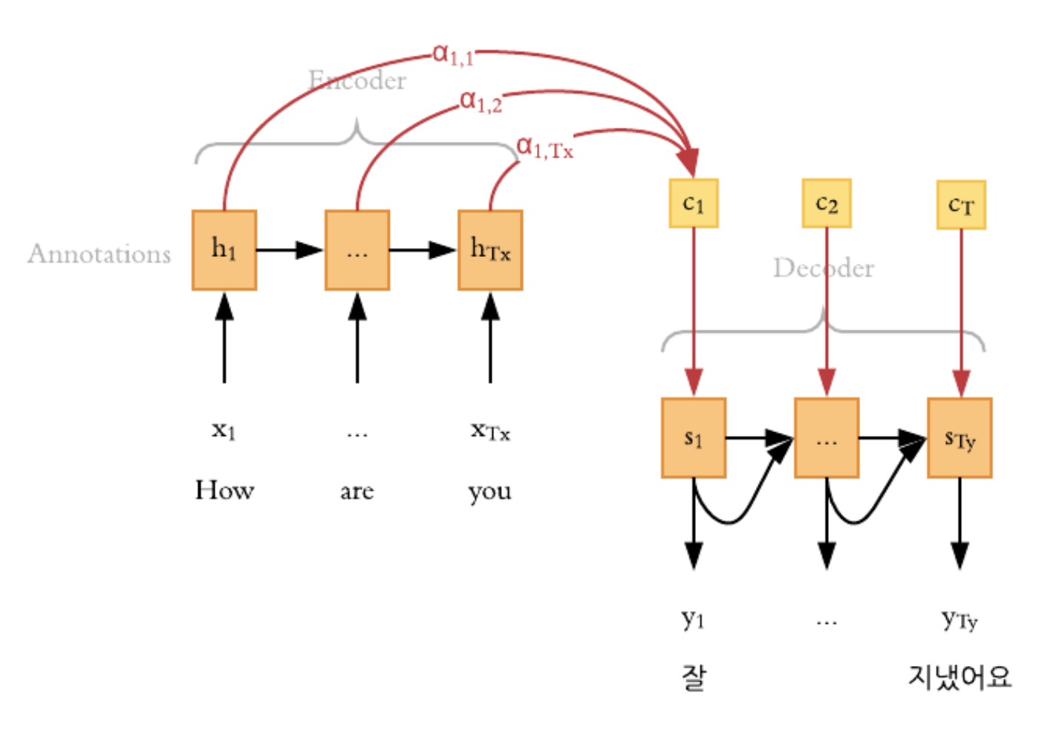
Background
Attention methods have been shown to improve upon the performance of standard encoder-decoder architectures
Intuitive figure demonstrating attention in machine translation:
Global vs Local attention: Output of one “token” in the output is dependent on all the hidden units in a weighted fashion (Global) or only on a few of the hidden units (Local)
Why Attention? To capture a much more holistic dependence on the output with respect to hidden states

Slide 4

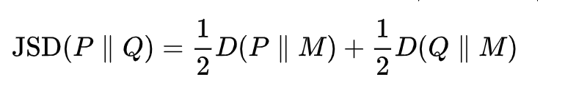
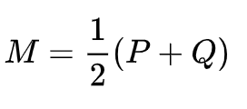
Background
TVD - Total Variation Distance:
Jensen Shannon Divergence:
For Correlation measurement : Kendal Tau
Encoder Model:
Average - simple
BiLSTM - recurrent

Slide 5
Related Work
Neural Machine Translation by Jointly Learning to Align and Translate - Bahdanau et al., 2014 (Attention Paper)
A causal framework for explaining the predictions of black-box sequence-to-sequence models. In Proceedings of the 2017 Conference on Empirical Methods in Natural Language Processing -David Alvarez-Melis and Tommi Jaakkola. 2017.
An interpretable predictive model for healthcare using reverse time attention mechanism, Advances in Neural Information Processing Systems - Edward Choi, Mohammad Taha Bahadori, Jimeng Sun, Joshua Kulas, Andy Schuetz, and Walter Stewart.

Slide 6
Claim / Target Task
Comparison with other techniques:
Correlation Between Attention and Feature Importance Measures - does the attention weights have any correlation with the gradient-based methods of interpretability
Modification of attention weights:
Attention Permutation- Permuting the weights of the attention on hidden states and checking if it makes a difference
Adversarial Attention - Adversarially computing new attention weights such that model predictions don’t change a lot but attention weights change a lot.
To perform these experiments over a variety of datasets on multiple tasks.
https://successar.github.io/AttentionExplanation/docs/
Notes:
Here, we make the claim of this project.

Slide 7
Data Summary
Datasets used can be divided on the basis of the task:
Binary text classification
Stanford Sentiment Treebank (SST)
IMDB Large Movie Reviews Corpus
Twitter Adverse Drug Reaction
20 Newsgroups (Hockey vs Baseball).
AG News Corpus (Business vs World)
MIMIC ICD9 (Diabetes)
MIMIC ICD9 (Chronic vs Acute Anemia)
Question Answering (QA)
CNN News Articles
bAbI
Natural Language Inference
SNLI dataset
Notes:
In the rest of this presentation, I’m going to talk about following contents:

Slide 8
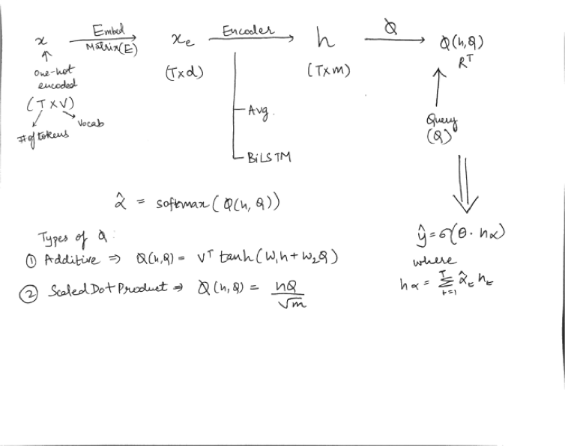
An Intuitive Figure Showing WHY Claim
Notes:
Here, we make the claim of this project.

Slide 9
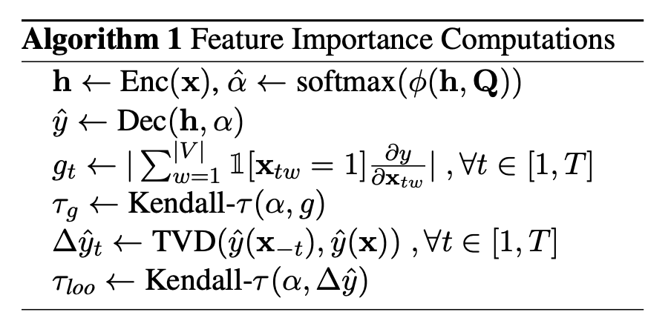
Proposed Solution
Experiment-1 Correlation between Attention Weights and Gradient/LOO
Calculating the correlation:
Tau_g -> corr. of gradients wrt attention weights
Tau_LOO -> corr. of leave one out wrt attention weights
Notes:
Here is our proposed solution.

Slide 10
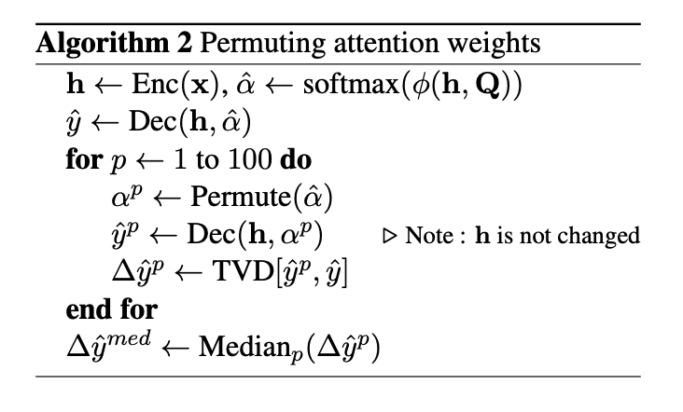
Proposed Solution
Experiment-2
Permuting Attention Weights
Notes:
Here is our proposed solution.

Slide 11
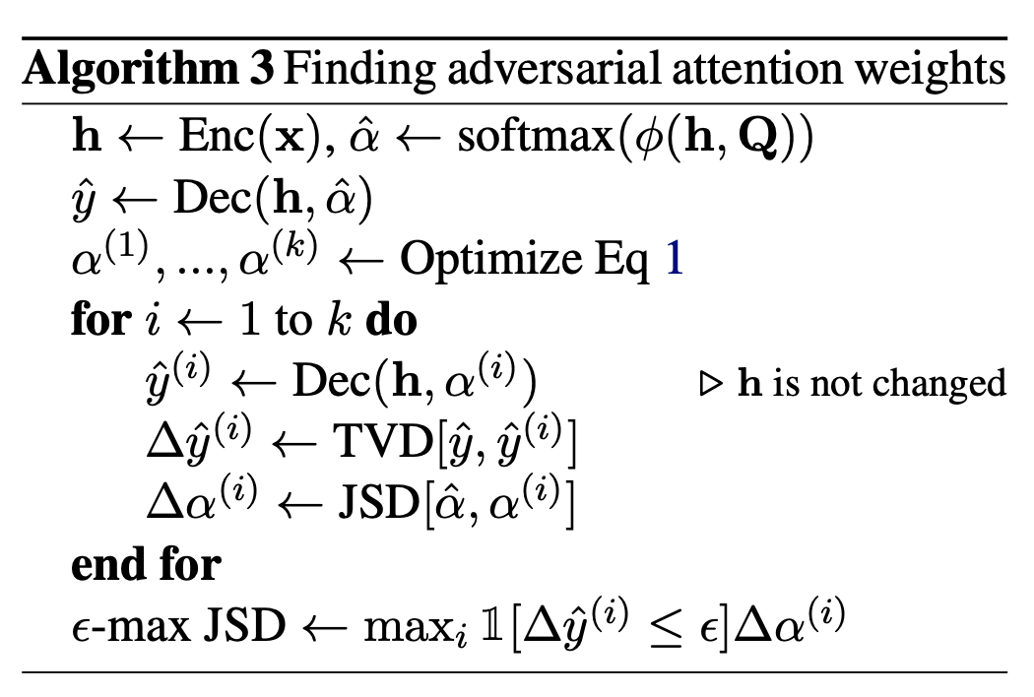
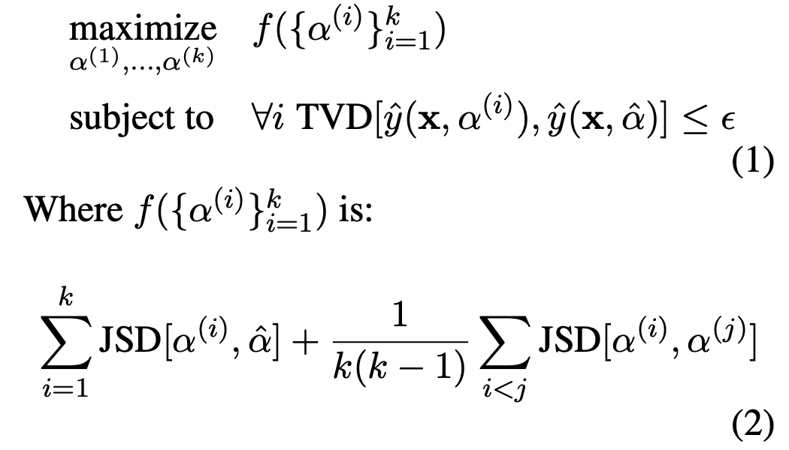
Proposed Solution
Experiment 2
Adversarial Attention - “attention weights that differ as
much as possible from the observed attention distribution and yet leave the prediction effectively unchanged.”
JS Divergence between any two categorical distributions irrespective of length) is bounded from above by 0.69.
Notes:
Here is our proposed solution.

Slide 12
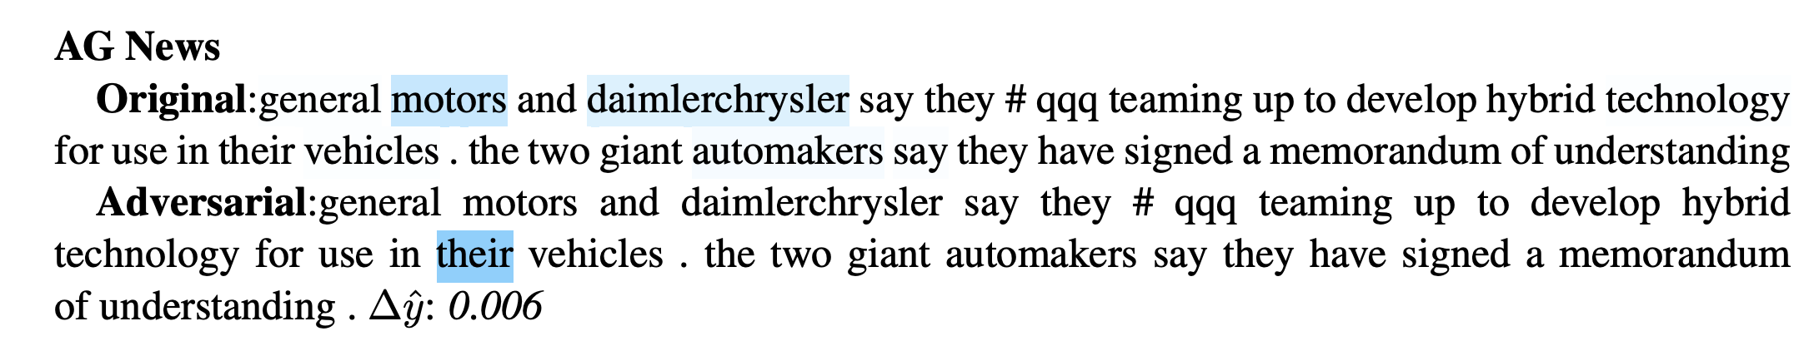

Slide 13
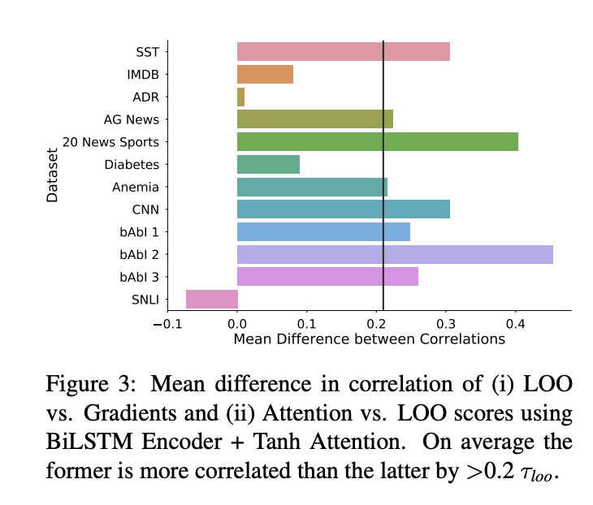
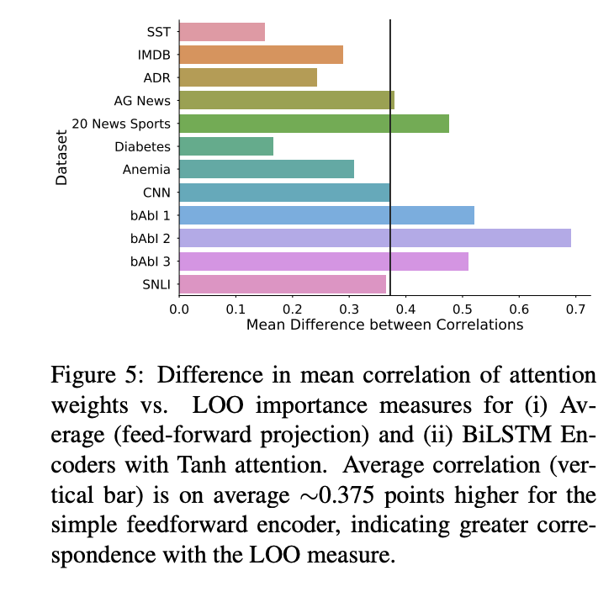
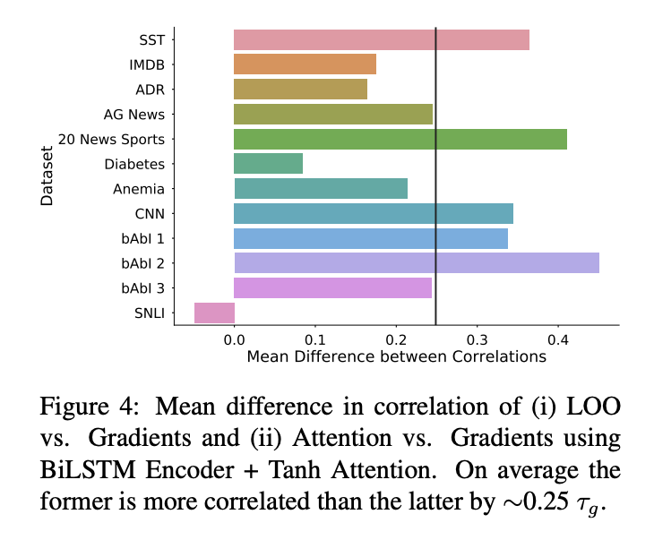
Experimental Results - Experiment 1
Notes:
In the rest of this presentation, I’m going to talk about following contents:

Slide 14
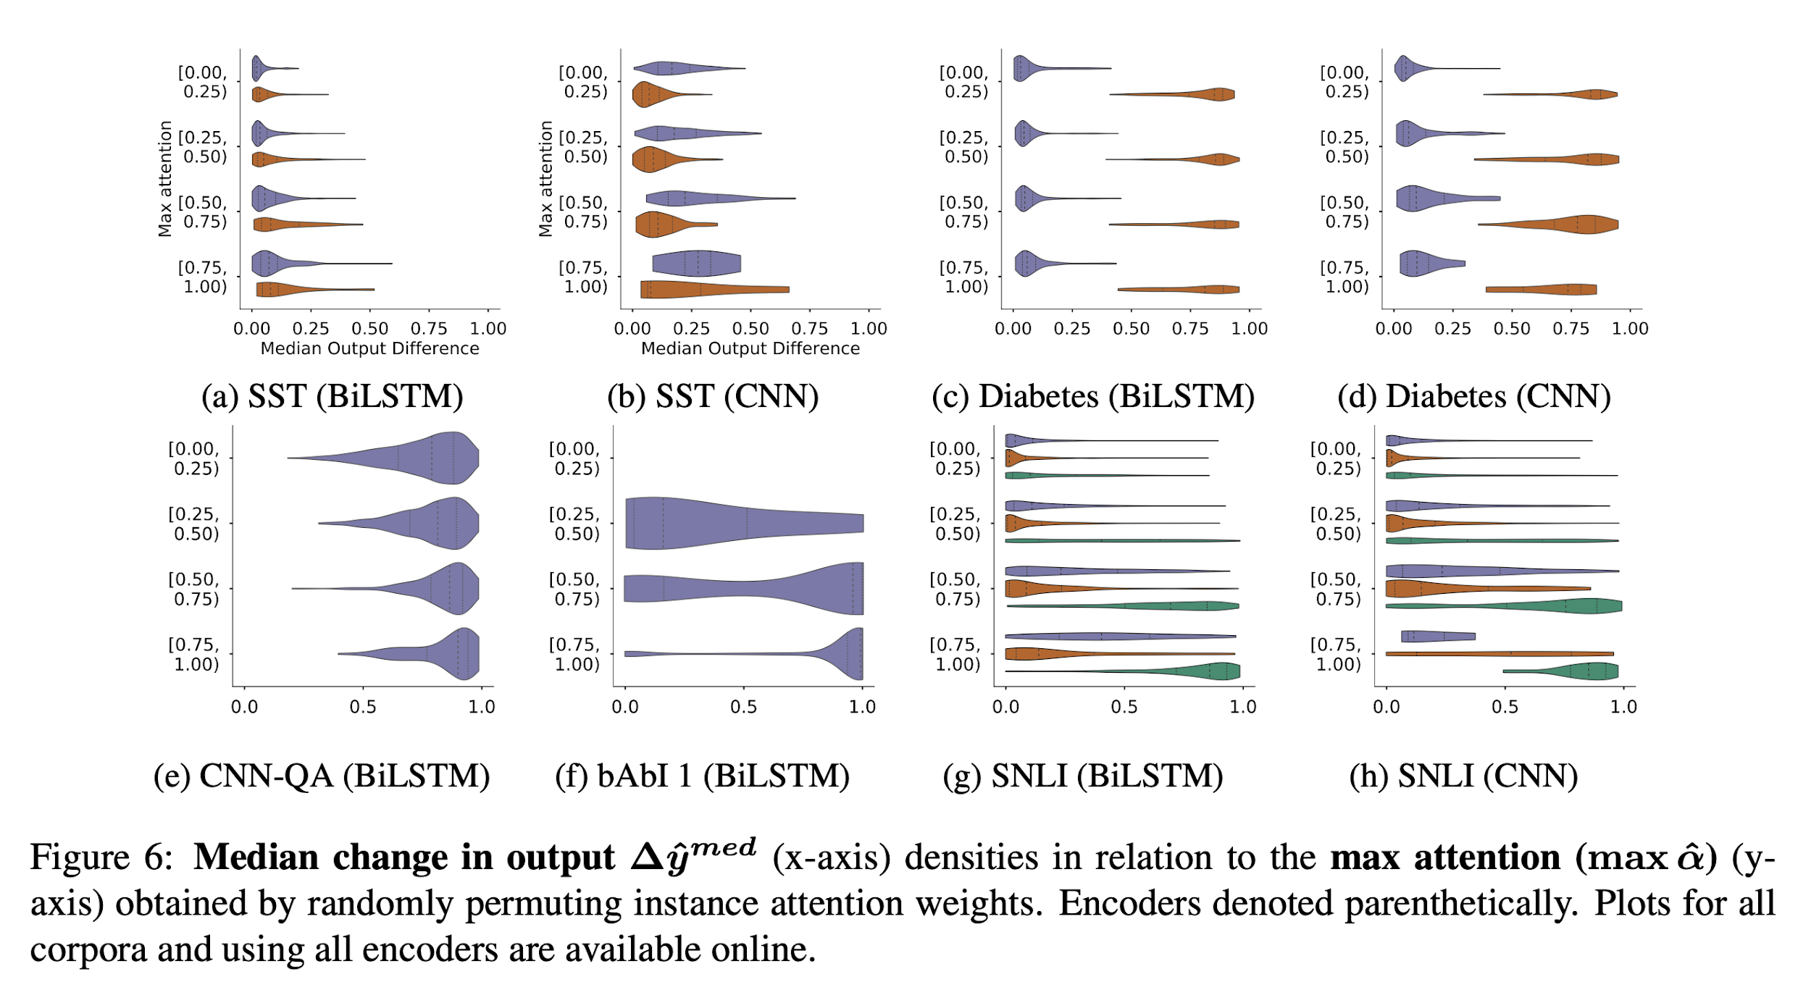
Experimental Results - Experiment 2a
Notes:
In the rest of this presentation, I’m going to talk about following contents:

Slide 15
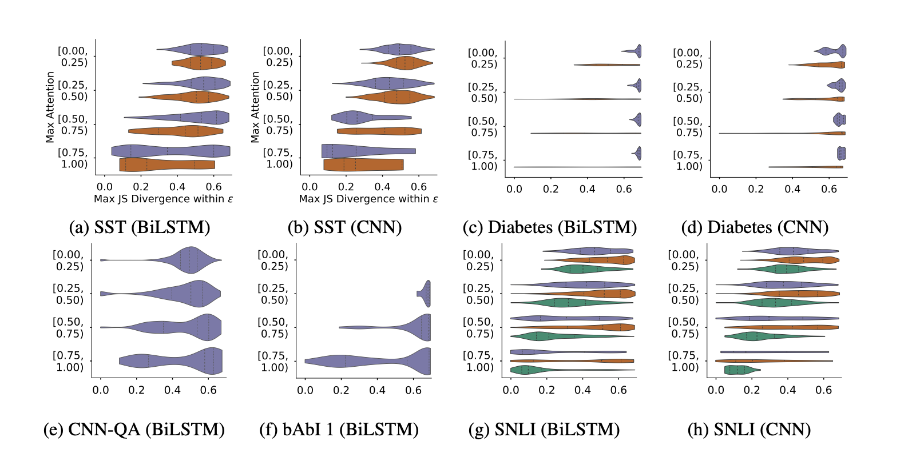
Experimental Results - Experiment 2b
Figure 8: Densities of maximum JS divergences (-max JSD) (x-axis) as a function of the maxattention (y-axis) in each instance for obtained between original and adversarial attention weights.
Notes:
In the rest of this presentation, I’m going to talk about following contents:

Slide 16
Experimental Analysis
Experiment-1 : Correlation study
Corr between LOO and Gradients is high
Corr between Gradients and attention and LOO and attention is on the lower side from expected
Corr of G/LOO vs attention for different encoders is different.
Simple encoders have high corr.(Average) and complex (BiLSTM) have low corr.
Experiment-2a: Perturbing attention weights
The change in output by perturbing attention weights is much lower than expected
Experiment-2b: Adversarial attention
“one can identify adversarial attention weights associated with high JSD for a significant number of examples. This means that it is often the case that quite different attention distributions over inputs would yield essentially the same output.
Notes:
In the rest of this presentation, I’m going to talk about following contents:

Slide 17
Conclusion and Future Work
Showed that there is much more research required in studying attention
Attention in itself is not enough to explain the models
The failure of explainability of BiLSTM over average encoders is much more concerning due to the fact that still complex models are not very well understood

